Slide 1

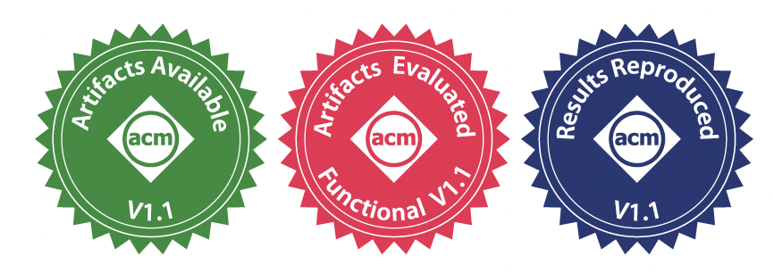


Serverless Replication of Object Storage across Multi-Vendor Clouds and Regions
Junyi Shu, Xiaolong Huang, Gang Huang, Hong Mei, Xuanzhe Liu, Xin Jin
Notes:
Hi, everyone. I’m Teng Ma from Alibaba Cloud. I’m presenting LambdaReplica, a serverless object storage replication system across different cloud providers on behalf of the authors, as they cannot make it to EuroSys due to visa issues.
This project was led by Junyi Shu at Peking University, who is now a postdoctoral researcher at UCLA.

Slide 2
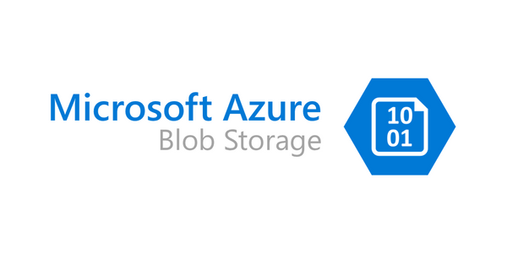
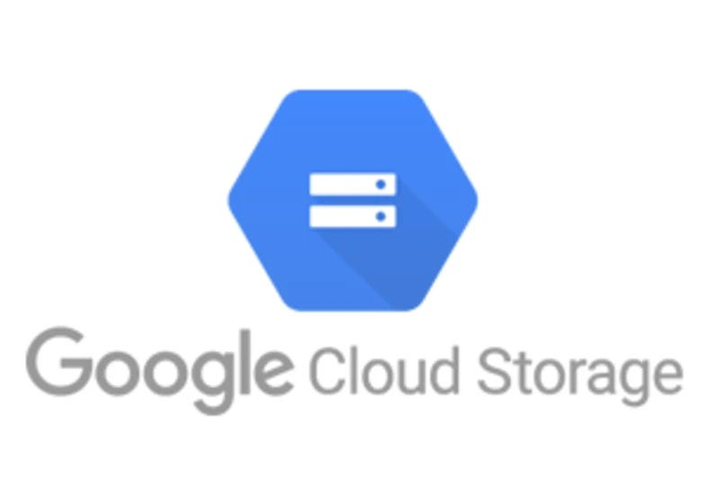
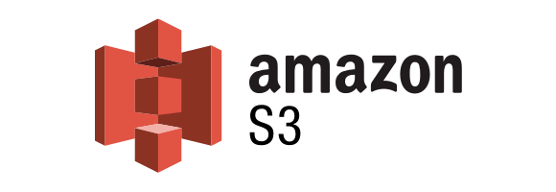
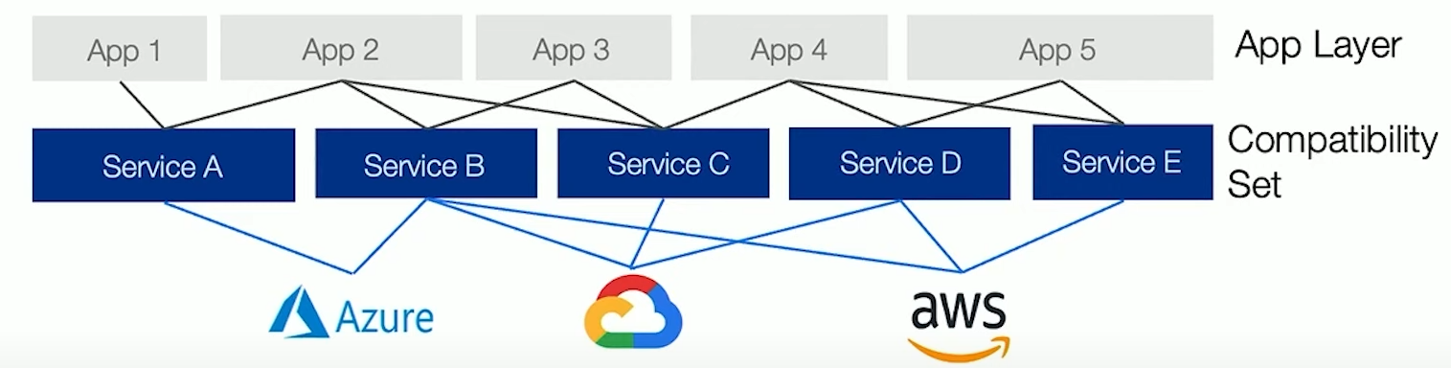
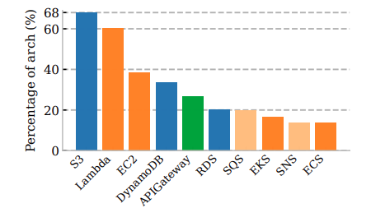

Object Storage
The most popular cloud service
Amazon S3/Azure Blob Storage/Google Storage
68% of the AWS-based cloud architectures use S3^{[1]}
Beyond a single cloud^{[2]}
Avoid vendor lock-in
Tolerate cloud/region-wide disasters
[1] [FAST ’25] Cloudscape: A Study of Storage Services in Modern Cloud Architectures
[2] [HotOS ’21] From Cloud Computing to Sky Computing
Notes:
Object storage is a storage service that manages data as discrete objects, each containing the data itself, metadata, and a unique identifier, and is designed for scalability and durability. Systems such as Amazon S3, Azure Blob Storage, and Google Cloud Storage have been among the most foundational cloud services since the early days of cloud computing. According to a recent FAST ’25 study, 68% of AWS-based cloud architectures use S3, making it the most widely used service in the ecosystem.
(Next)
Today, there is also a growing trend of moving beyond a single cloud for object storage. There are two main motivations here. First, avoiding vendor lock-in, organizations don’t want to be tied to a single provider in terms of pricing, features, or ecosystem. Second, improving reliability by tolerating region- or even cloud-wide failures. And this is not just a theoretical concern. Real-world incidents have shown the risks. For example, Google Cloud once accidentally deleted UniSuper’s data due to misconfiguration.

Slide 3
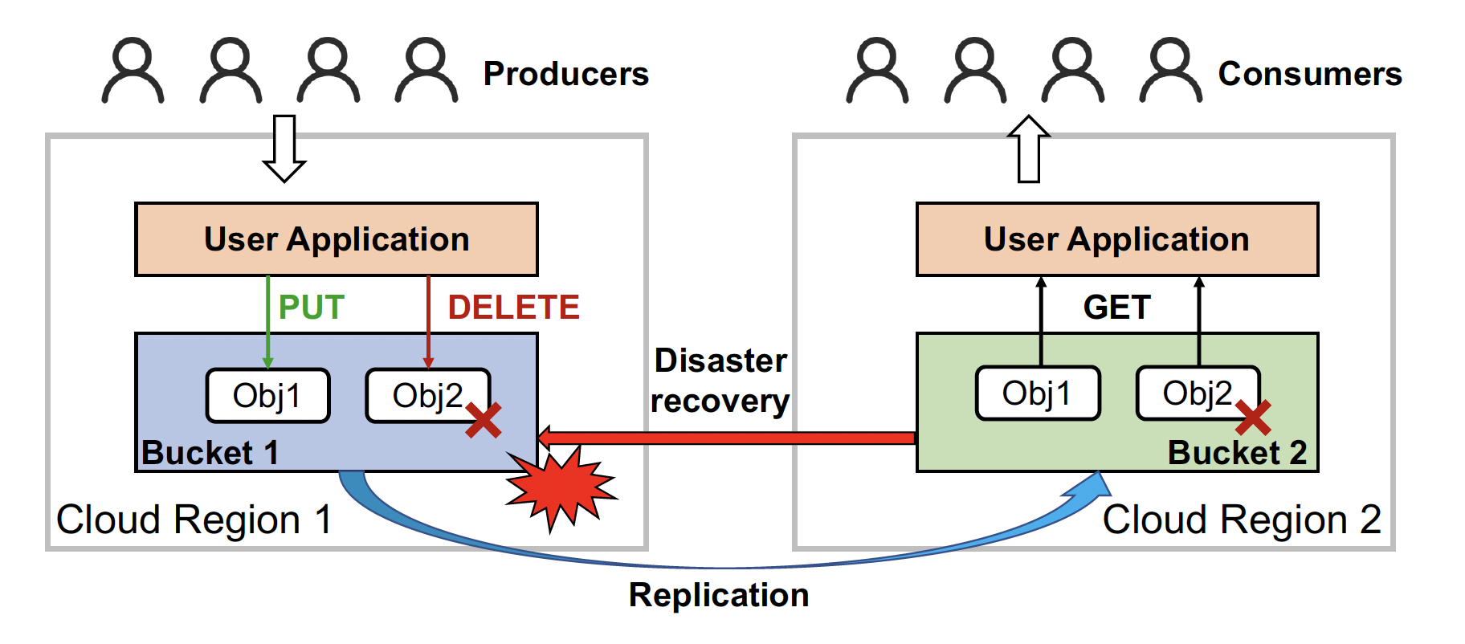
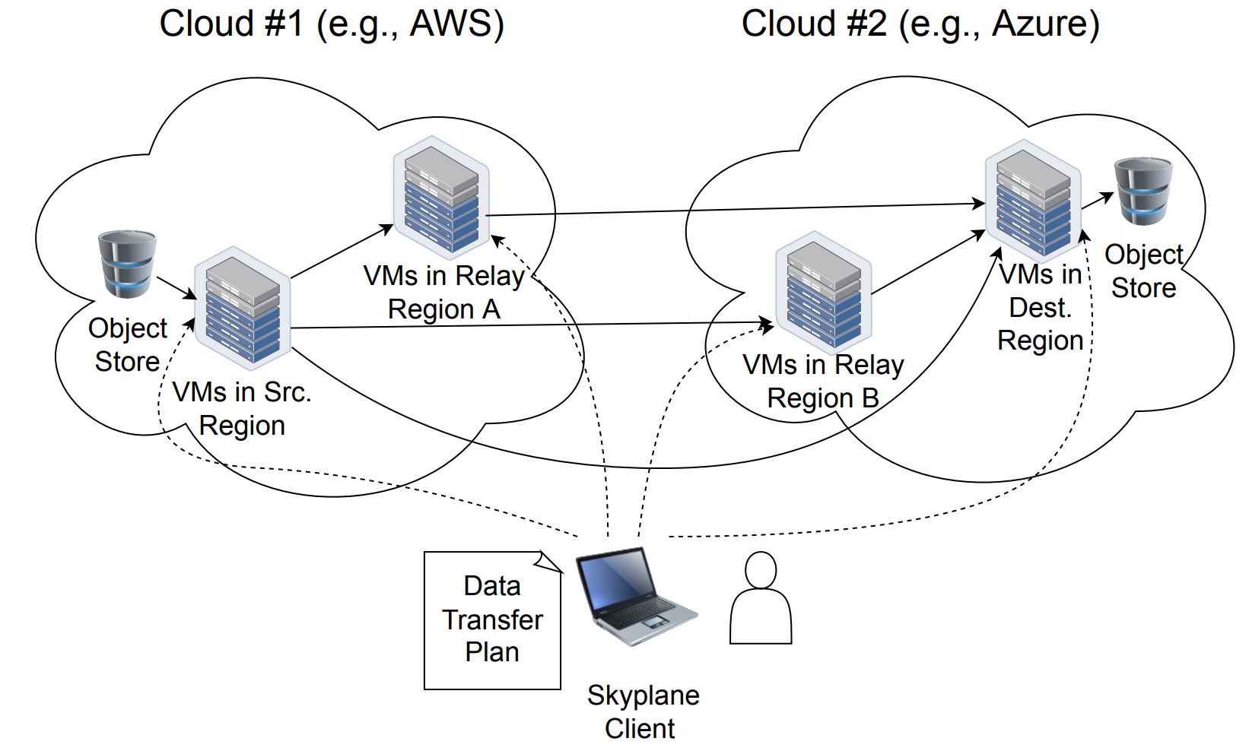
Object Replication across Clouds
Need replication for availability, reliability, and better access latency
Status quo
  No built-in support from cloud providers
  Most use cases only require asynchronous replication
Skyplane^{[1]}
[1] [NSDI ’23] Skyplane: Optimizing Transfer Cost and Throughput Using Cloud-Aware Overlays
Notes:
The need for availability, reliability, and better access latency directly leads to robust and low-overhead cross-cloud data replication mechanisms.
However, if we look at the status quo, there are still significant limitations.
First, cloud providers do not offer built-in support for cross-cloud replication. While they provide replication within their own infrastructure, going across providers typically third-party solutions.
Second, most real-world use cases only require asynchronous replication. That is, strong consistency is too expensive and unnecessary for a primary-secondary model we show here.
(Next)
Today, to enable object replication across clouds, you can use Skyplane, an open-source tool that uses VMs to move your data. This approach is both general and efficient for copying bulk data across clouds because every cloud offers VMs and the overhead of creating a VM is negligible when you transfer something like model weights of an LLM.

Slide 4
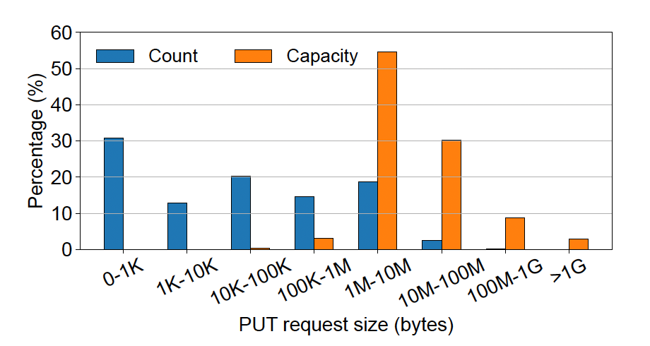
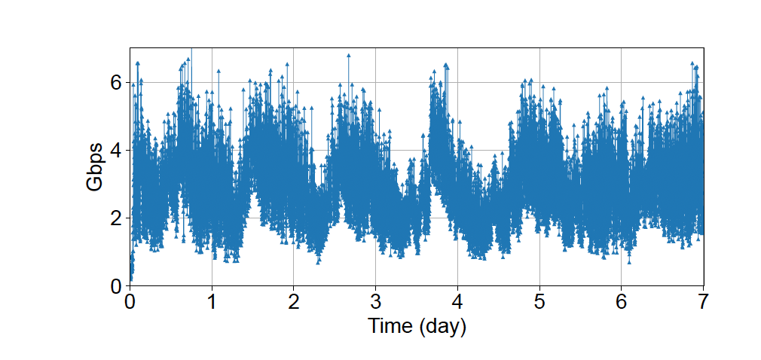
Characteristics of Object Storage^{[1]}
Observation #1: Diverse size distribution, small objects dominate
Observation #2: Highly variable request rate
[1] [HotStorage ’20] It's Time to Revisit LRU vs. FIFO
Notes:
But is this enough for object replication across clouds? To answer this question, we took a deep look at the usage patterns of object storage.
This is from the traces of IBM cloud object storage, which covers all of the request in about 100 buckets for a whole week. We draw two important observations by analyzing the traces:
First, the object sizes are highly diverse, which means you need to be able to handle any size. But objects that are smaller than 1MB account for more than 90% of the PUT requests, which means an efficient replication system should really optimize for small ones.
(Next)
Second, while we can clearly observe a diurnal pattern, what’s more important is the short-term variability. If we zoom in, we can see that the throughput fluctuates significantly from minute to minute. This means an efficient replication also needs to adapt to these rapid, unpredictable traffic changes.

Slide 5
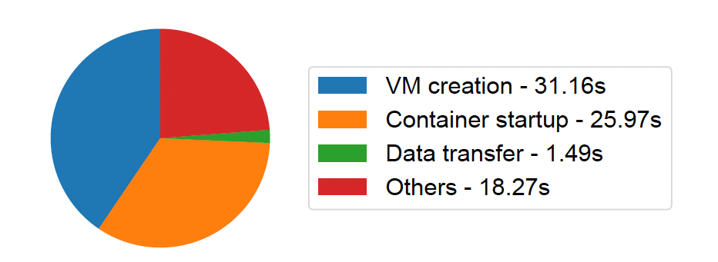
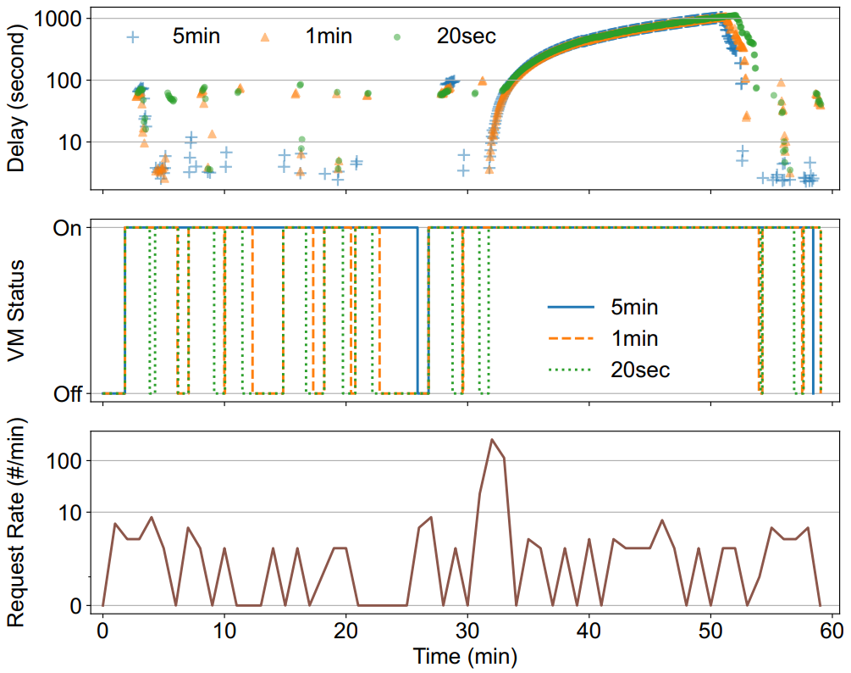
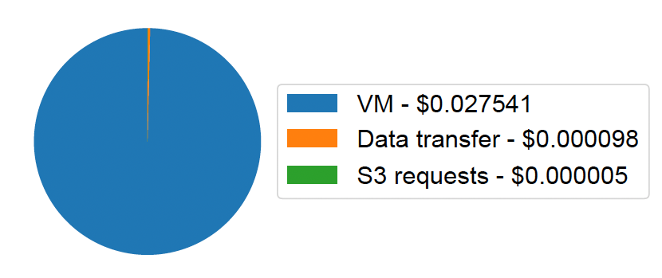
Why the VM-based Approach Fails
One-time transfer of a 10MB object
VM-related overhead dominates time and cost
Replaying a 60-minute trace with 2 VMs
Cold starts and queuing delays
Cold starts
Growing queue
VM-based solutions are ill-suited for bursty workloads and tiny objects
Notes:
So are VM-based approaches like Skyplane ideal for the traffic pattern we observed?
First, we did a simple experiment of transferring a 10MB object with Skyplane. Ideally, this should be very fast and cheap. However, as shown in the breakdown, the actual data transfer only takes about 1.5 seconds, while the majority of the time is spent on VM creation and container startup. The same issue appears in cost. The vast majority of the cost comes from provisioning and running VMs, while the actual data transfer and S3 requests are almost negligible.
(Next)
Now, let’s move to a more dynamic scenario. Here, we replay a 60-minute IBM object storage trace using two VMs. What we observe is that replication delay becomes highly unstable with dynamic workloads.
(Next)
First, when VMs are shut down after a period of idleness, subsequent replications incur high latency due to cold starts.
(Next)
Second, under high load, VMs can become congested, leading to significant and sustained queuing delays.
(Next)
The key issue is that VM-based approaches are too coarse-grained and slow to adapt. They cannot efficiently handle tiny objects or bursty workloads.

Slide 6
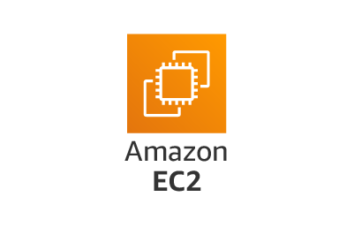
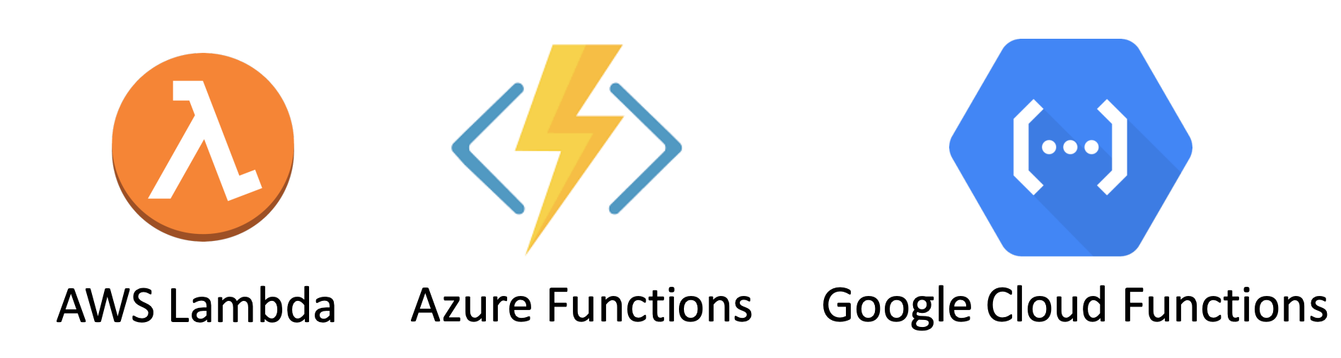
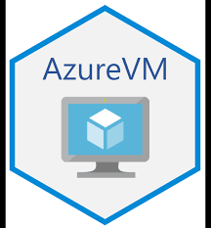


From VM to Serverless Computing
VM Creation: 30-120s
Function Invocation: <1s
But are serverless functions capable of transferring objects across clouds?
Notes:
So, a natural idea is to replace VMs with serverless computing, or more specifically Function-as-a-Service, FaaS. Unlike VMs, which can take tens of seconds to provision, serverless functions are typically created in under a second, even for cold starts which everyone criticizes and tries to optimize. It seems using serverless computing can significantly reduce the latency when scaling up.
(Next)
However, while serverless functions are commonly used to download and upload objects within a single cloud region, their behavior in cross-cloud or cross-region settings is much less understood. Unlike VMs, for which cloud providers often offer bandwidth SLOs, there is little prior work characterizing the bandwidth that serverless functions can achieve for cross-cloud data transfer, or whether they can reliably handle objects of arbitrary sizes.

Slide 7
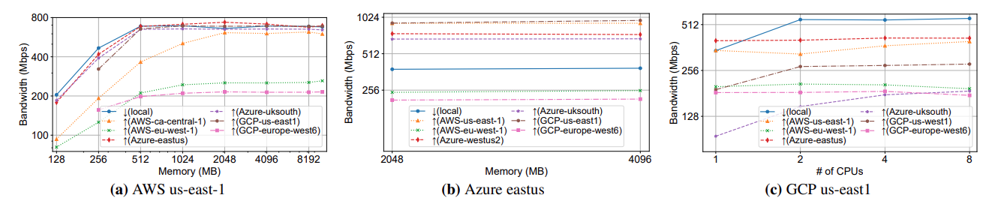
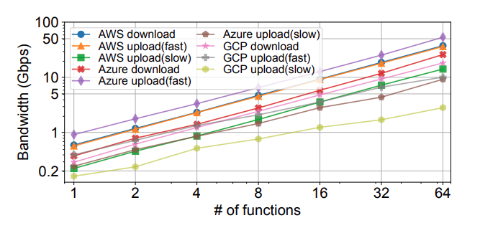
The Light Side: Average Performance
Question #1: Does a single function instance provide enough bandwidth?
Question #2: Does the performance scale if I increase the parallelism?
200Mbps-1Gbps
Scales linearly
Notes:
So here are the two very basic questions we want to ask: Question 1, does a single function instance provide enough bandwidth? We really hope a single function can handle most of the small objects to avoid us trouble on dealing with concurrency. Question 2, if we really want to accelerate data transmission, are we able to do so just by adding more functions?
(Next)
First, across AWS, Microsoft Azure, and GCP, bandwidth varies significantly depending on the source and destination regions. However, in general, it falls within a few hundred megabits per second, which is higher than we initially expected. For comparison, even a powerful VM typically provides around 5 Gbps. This also means that a single serverless function can reliably transfer a 10MB object within a few seconds.
(Next)
Second, it is crucial for us to be able to scale performance, for two main reasons. First, unlike VMs with effectively indefinite lifetimes, most serverless platforms impose execution time limits. To handle arbitrarily large objects within these limits, we need to scale out the transfer. Second, in practice, replication systems must meet certain SLOs for replication delay. For example, AWS guarantees a 15-minute delay SLO for intra-cloud replication. From our extensive experiments, we observe that performance scales nearly linearly up to 64 functions, and even beyond, which is very encouraging.

Slide 8
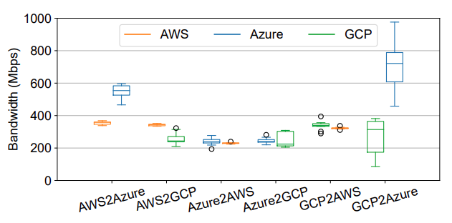
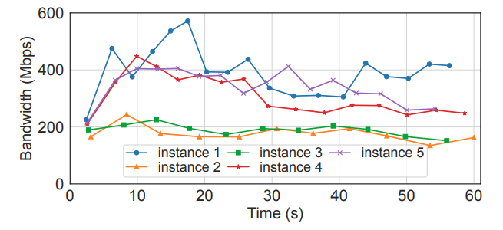
The Dark Side: Performance Variability
Across clouds and regions
Performance is asymmetric
Even when the (src, dst) pair is fixed
Across function instances
Some instances are constantly faster
Bandwidth fluctuates over time
Notes:
But we also observe some unexpected behaviors along the way, which create challenges for adopting serverless computing for cross-cloud object replication.
First, we examine bandwidth across clouds and regions. The key takeaway is that performance is highly asymmetric. Even when the source and destination pair is fixed, the bandwidth can still vary substantially depending on where you spawn the serverless function.
(Next)
Second, we look at multiple function instances over time. Here, we see two things. First, some instances are consistently faster than others, even though they are invoked in the same way. Second, bandwidth fluctuates over time, so performance is not stable even within a single instance.
Taken together, these results show that data transfer performance of serverless computing is not only heterogeneous across clouds and regions, but also variable across individual function instances and over time. A robust and efficient system must be able to deal with this performance variability.

Slide 9
𝜆Replica Design Outline
Challenge #0: How to ensure correctness of replication?
  Concurrency control to avoid race conditions
Challenge #1: How to find a replication plan to satisfy a given SLO?
  Performance modeling for using a single function and parallel functions
  Awareness of performance variability to meet the SLO
Challenge #2: How to mitigate stragglers when running in parallel?
  Adaptive adjustment for load distribution among worker functions
Notes:
Here we outline the challenges that the proposed system LambdaReplica needs to address in its design. The first challenge is planning: how do we find a replication plan that satisfies a given SLO? This requires performance modeling, both for a single function and for parallel execution. More importantly, we need to explicitly account for performance variability, which we showed earlier, in order to meet the SLO with high confidence.
(Next)
The second challenge is straggler mitigation: it’s almost certain there will be underperforming function instances when running in parallel. How do we avoid them becoming stragglers. Since different instances can have very different performance, we need adaptive mechanisms to dynamically adjust load distribution among workers.
(Next)
On top of that, an implicit challenge is correctness: how do we ensure correct replication? In particular, when there are concurrent replication tasks or when we replicate an object with parallel workers, we need proper concurrency control to avoid race conditions. Existing VM-based solutions are mostly for bulk replication of static objects, which do not handle this promptly.
These three challenges together guide the design of LambdaReplica.

Slide 10


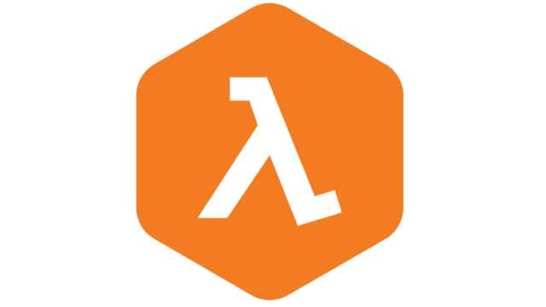
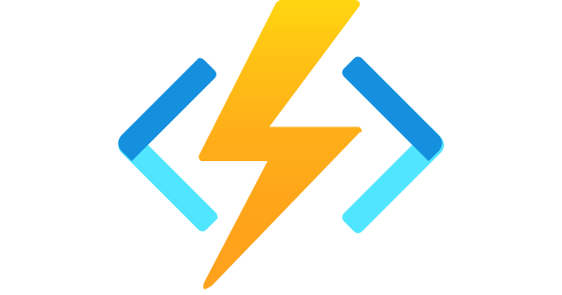
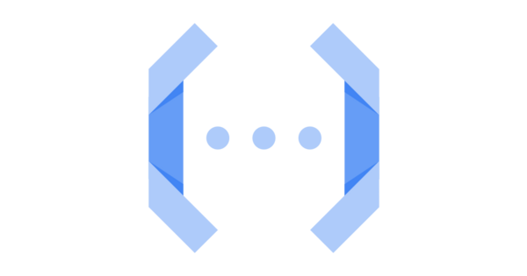







𝜆Replica Overview
System Architecture
Completely serverless
Integrable with event notifications
Replication workflow
One-sided replication
Decouple orchestration and data movement
…
Object Event Notifications
⓪
Offline
Online
PUT(Obj1)
Strategy
Planner
Obj1
Obj1
Performance Profiler
Logger
Bucket 1
③
Bucket 2
①
Replication
Engine
notifies
downloads
④
②
uploads
event
listener
invokes
replicator
Cloud Database
Cloud Region 1
Cloud Region 2
Notes:
Before we dive into the technical details on how we address these challenges, l will give a high-level overview of LambdaReplica on what it is and how it handles repliation. It has an online strategy planning module to generate the replication plan, and it heavily rely on offline modeling of the replication performance of serverless functions. It efficiently replicates object data to other cloud regions using a replication engine. Both strategy planner and replication engine are essentially serverless functions. And any underlying states are kept in serverless databases. Therefore, LambdaReplica is fully serverless, meaning when there is no replication task, the cost is zero. In addition, it can be integrated with object events that cloud platforms usually provide. So there is no effort required on the side of cloud providers.
(Next)
The basic replication workflow of LambdaReplica is as follows:
(Next)
First, when a user requests the creation of a new object,
(Next)
the cloud platform detects this via an event notification listener.
(Next)
The listener internally invokes the strategy planner,
which initiates replication functions based on the strategy.
(Next)
The replication functions use the replication engine to download data from the source bucket.
There are two things I want to note here: First, unlike VMs which can talk to each other, a function can invoke another but cannot establish a network channel between functions. So unlike VM-based approaches which spawn VM in both source and destination regions. We only run our replicator functions in either the source or the destination region according to the replication plan. Second, we decouple the planner and replicator, but like prior work has demonstrated, function invocation has overhead, so we opportunistically fuse them for tiny objects to reduce the overhead.

Slide 11
Inconsistency vs. Versioning
User
PUT
(key, v1)
PUT
(key, v2)
Concurrent writes: undefined behavior
event
Replication
Task v2
event
v2=
GET(key)
PUT-remote
(key, v2)
v1?
v2?
Replication
Task v1
v1=
GET(key)
PUT-remote
(key, v1)
Time
Parallel replication: inconsistent chunks
PUT
(key, v1)
PUT
(key, v2)
event
1. Lock
Performance
Faults
v1_p1=
GET(key, p1)
PUT-remote
(key, p1, v1_p1)
2. Versioning
Cost
Orchestrator
invoke
v2_p2=
GET(key, p2)
PUT-remote
(key, p2, v2_p2)
Time
Notes:
Before we touch the performance optimization, we have to ensure the correctness, which means for every object, the exact same object or a newer version has to be eventually replicated to the destination. We identify there are two cases that this promise can be broken.
First, when a replication task is still ongoing and a newer version of this object is created. (Next) Two tasks may try to call PUT object API concurrently. For object storage, it results in undefined behavior, which means it could v1, v2, or even corrupted.
(Next)
Second, when we replicate a large object, we need to spawn multiple parallel replicator functions. These functions cannot be created at the exact same time, (Next) if the object is updated in between, we will create an object that consists of chunks from different versions.
(Next)
We can see what’s causing problem here is user updates during replication tasks. An easy mitigation will be preventing user updates with a lock. But this inevitably hurts the main replica’s performance and increases the number of faults.
(Next)
Alternatively, cloud platforms require users to enable versioning if they want to use the built-in intra-cloud replication service. It prevents interference between versions, but storing multiple versions usually doubles the storage cost at least.

Slide 12

Object-Level Replication Lock
Key Idea: Lock the replication task instead of the object as a whole
PUT(objA, v2)
Replicate objA, v1
acquire
release
trigger
fail
objA | v1
Replicate objA, v2
objA | v2
Prevents concurrent PUT requests in a serverless manner
Opportunistically reduce # of replication tasks
Notes:
For the first correctness issue, our key idea is to lock the replication task, rather than the object itself. To handle concurrent writes, when a replication task starts, LambdaReplica first acquires a lock for the object in a cloud database. (Next) If another concurrent replication task tries to acquire the lock, it will fail. Instead, it updates the version information associated with the lock. (Next) When the lock is eventually released, the system checks the current version recorded in the lock and decides whether the pending replication task should still proceed.
(Next)
This design prevents concurrent PUT requests from interfering with each other in a serverless manner, and it also lets us opportunistically reduce the number of replication tasks. In other words, if multiple updates arrive close together, we can avoid redundant replication and only propagate the last one of them.

Slide 13
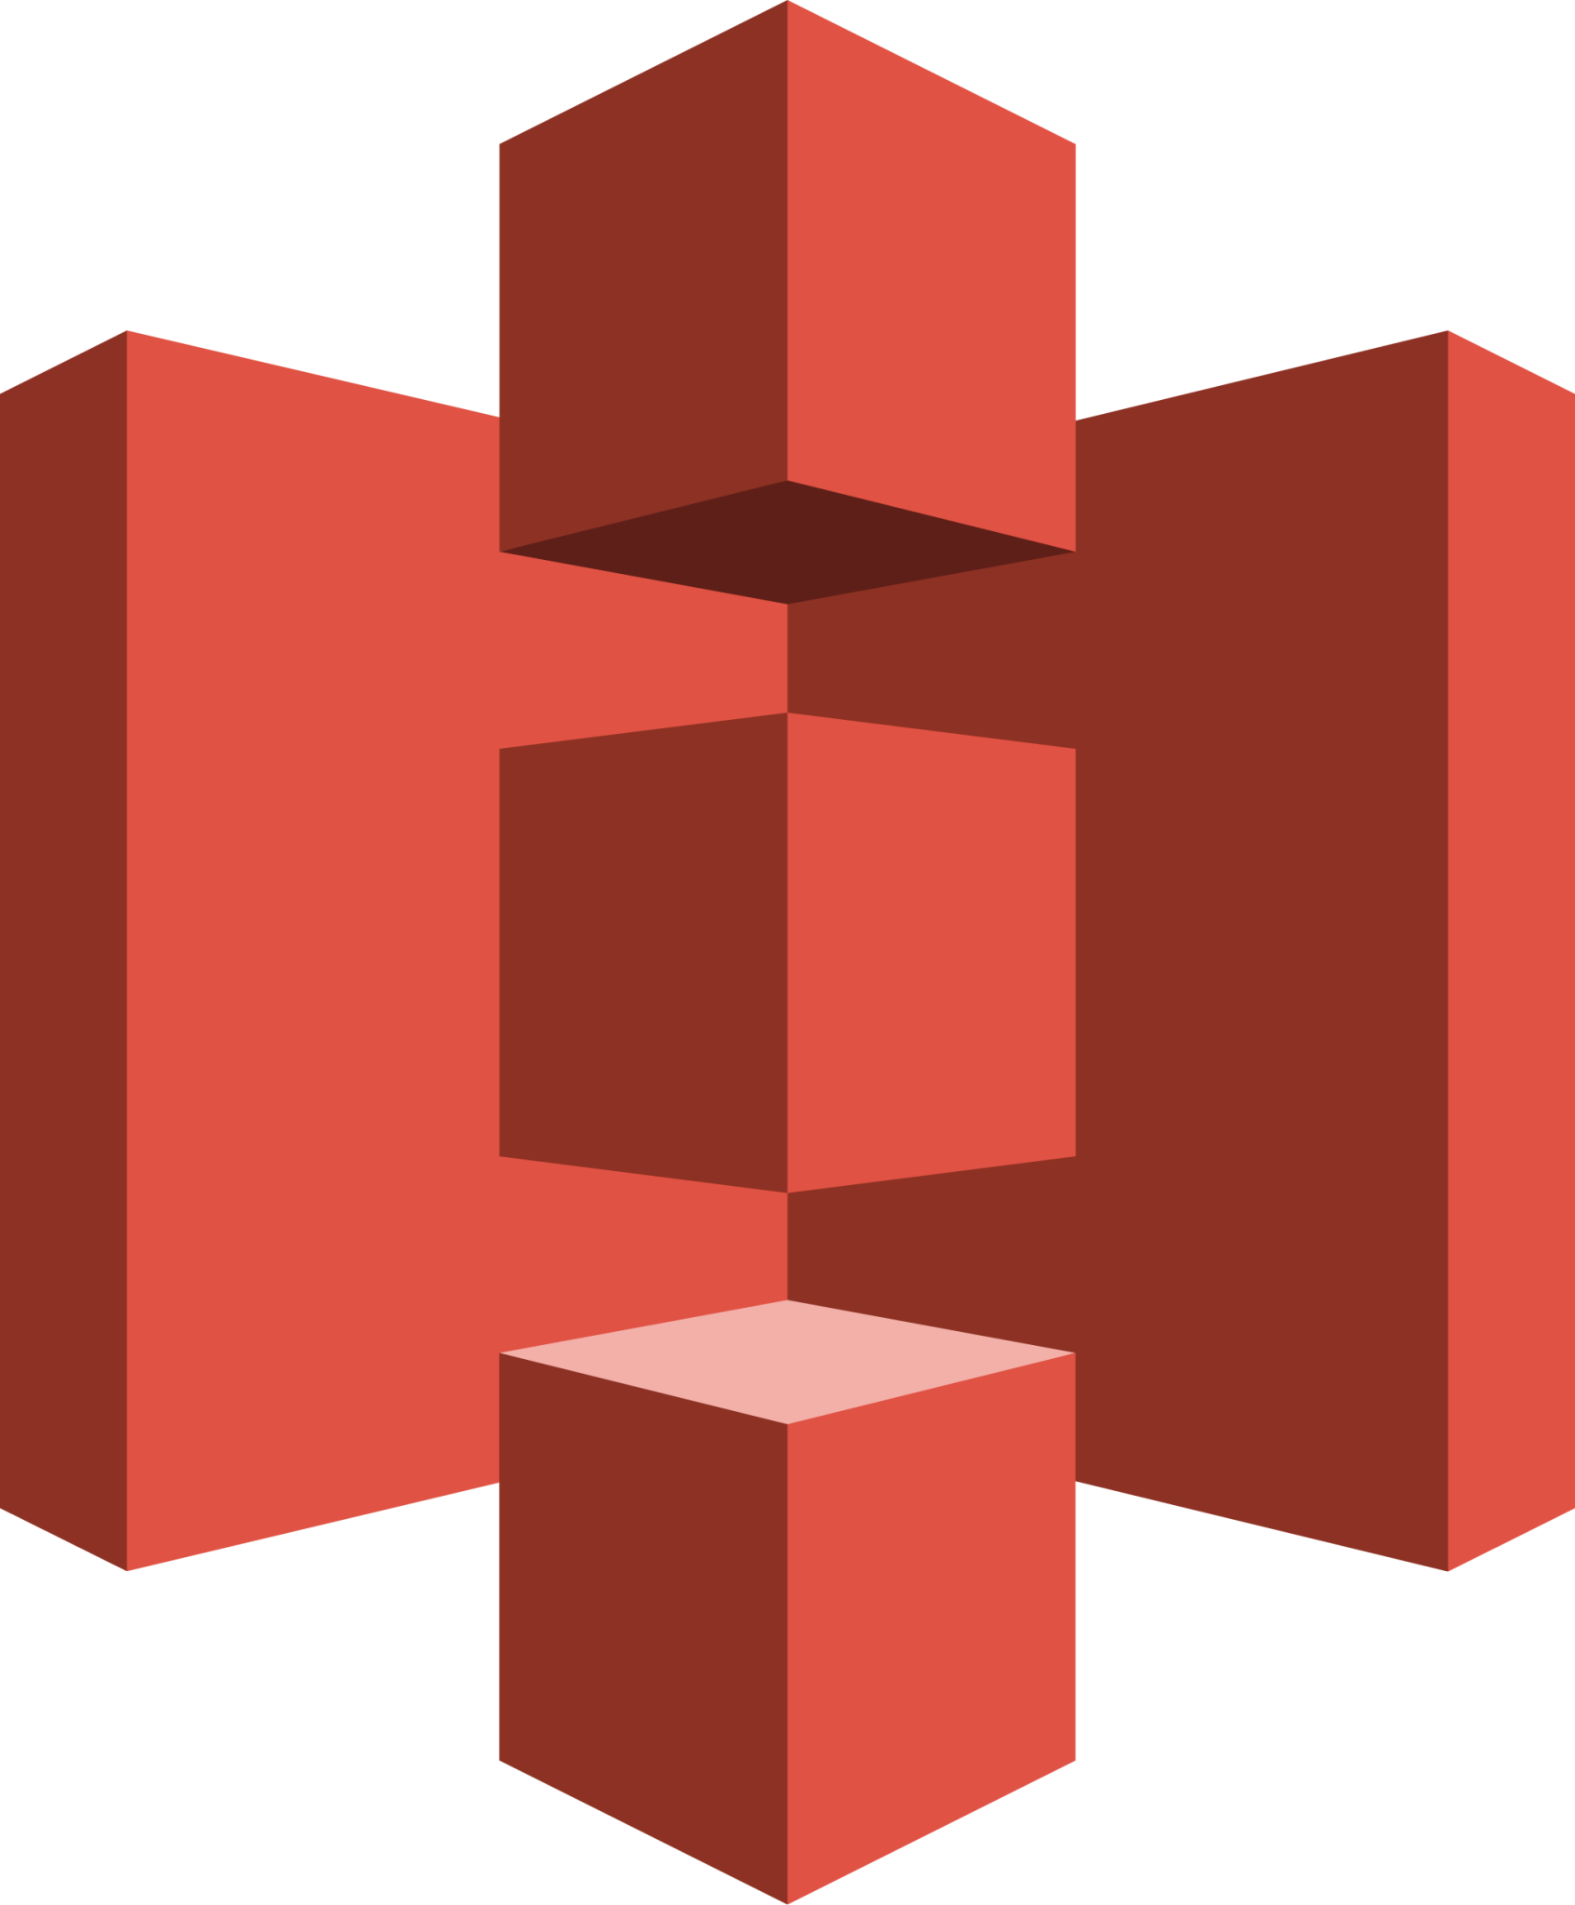
Optimistic Parallel Replication
Key Idea: Proceed optimistically until version match is detected
Start over
v2
Replicate objA, p1, v1
Replicate objA
Get latest version
v1
Replicate objA, p2, v1
v1
Completely avoids locking which prevents user updates
Notes:
For parallel replication, as it happens less frequently, our solution is to proceed optimistically until a version mismatch is detected.
LambdaReplica first fetches the current version of the object. (Next) It then optimistically invokes all replication functions in parallel, asking them to replicate that same version. (Next) During execution, if all functions observe a consistent version, the replication completes successfully. However, if any function detects a version mismatch, indicating that a new update has occurred, the entire replication task is aborted and restarted with the latest version.
(Next)
The key advantage of this approach is that it completely avoids locking. As a result, we do not block user updates, enabling high concurrency and better system responsiveness

Slide 14
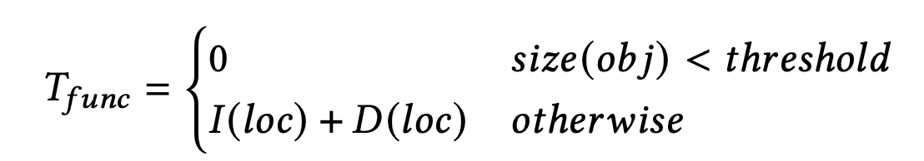
Modeling Replication Time of a Single Function
Problem: Cannot profile every different object size
Solution: Build an analytic performance model whose parameters can be profiled
Planning
Function
Invocation
Data Transfer
Notes:
Next, to generate a replication plan that satisfies a given SLO, we need to know the estimated replication time for a certain plan. We start with a simple case of a single function. We cannot profile every possible object size. In practice, object sizes vary widely, so exhaustive measurement is simply infeasible. Our solution is to build an analytic performance model, where the key parameters can be profiled once and then generalized to different object sizes. As shown here, after plan generation, there are two main components: an optional function invocation, and data transfer.
(Next)
For function invocation, the latency depends on whether the object size exceeds a certain threshold. If the object is small, because we fuse the planner and replicator, there is no function invocation. Otherwise, we model it as the sum of API calling time and a invocation delay at a given cloud region.
(Next)
For data transfer, we model it using a simple linear form. There is a fixed base time, and then a per-chunk transfer time that scales with the object size. By combining these components and substitute the profiled variables as distributions, we can estimate the total replication time at a confidence interval for different object sizes and configurations, without needing to profile each of them individually.

Slide 15

Modeling Replication Time of Parallel Functions
Problem: Cannot profile every different object size
Solution: Build an analytic performance model whose parameters can be profiled
Planning
I1
I2
I3
Take the maximum with Monte Carlo Methods
D1
T1-1
T1-2
T1-3
……
D2
T2-1
T2-2
T2-3
……
D3
……
T3-1
T3-2
T3-3
Scheduling Dealy
Notes:
Next, we extend our model to parallel functions. The key difference here is that replication is now performed by multiple functions in parallel. As we show here, we first invoke multiple function instances, split the object into chunks, and each function transfers a portion of the data.
(Next)
For function invocation, the total cost now scales with the number of functions. We model it as the invocation overhead multiplied by the number of functions. We add an additional scheduling latency because when scaling out, we observe platforms like GCP takes up to five seconds to make the scheduling decision.
(Next)
For data transfer, the total completion time is determined by the slowest function, since all chunks must finish before replication completes. Therefore, we take the maximum transfer time across all parallel functions. To capture performance variability, instead of using a single deterministic value, we estimate this maximum using Monte Carlo methods. This allows us to account for the variability across instances and over time that we observed earlier. By combining these, we can estimate the total replication time under parallel execution and choose an appropriate level of parallelism to meet the desired SLO.

Slide 16

The Straggler Effect under Performance Variability
Problem: Distributing chunks evenly causes slow ones to become the bottleneck
Object
Function 1
Function 2
100Mbps
400Mbps
Can we dynamically adjust chunk assignment?
Notes:
Once we have a replication plan, we still need to handle the performance variability across the function instances.
The problem is that if we simply distribute chunks evenly across functions, slower instances can become the bottleneck.
For example, as shown here, suppose we split the object evenly between two functions. One function runs at 100 Mbps, while the other runs at 400 Mbps. Even though the second function finishes quickly, the overall completion time is still determined by the slower one.
On the right side is the execution time from an actual replication task, execution time can vary significantly across functions. A lot of them finish within 10 seconds, while the slowest ones take more than 20 seconds.
(Next)
So the key question becomes: can we dynamically adjust chunk assignment to better balance the load and mitigate stragglers?”

Slide 17
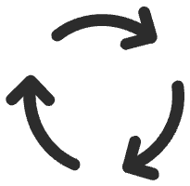
Delayed and Finer-Grained Task Assignment
Key Idea: Create smaller chunks, and do not assign until a worker becomes idle
……
Function 1
Function 2
100Mbps
400Mbps
Notes:
To address the straggler problem, we propose delayed and finer-grained task assignment. The key idea is to break the object into smaller chunks, and instead of assigning them upfront, we only assign work when a function becomes idle.
More concretely, LambdaReplica divides the replication task into fine-grained units and places them in a cloud database. Each function dynamically pulls tasks from this shared pool as it progresses. This allows faster functions to process more chunks, while slower ones handle fewer, naturally balancing the workload across instances.
As a result, we can effectively mitigate the straggler effect and achieve much more balanced execution times. The figure on the right shows that compared to a fair, static assignment, this fine-grained, dynamic approach allows functions to finish around the same time.

Slide 18
Evaluation
Implementation
  Approximately 5,200 lines of Python code
Testbed
  Cloud platforms: Amazon AWS, Microsoft Azure, Google GCP
  Cloud regions: 3 regions selected from each cloud platform
  Serverless compute platforms: AWS Lambda, Azure Functions, Google Cloud Run
  Cloud databases: AWS DynamoDB, Azure CosmosDB, Google Firestore
Baselines
  Open-source cross-cloud replication system Skyplane
  Native intra-cloud replication features of AWS and Azure
Workload
  Replication of artificially generated objects sized 1MB, 128MB, 1GB, and 100GB
  Replay of IBM Cloud Object Storage traces
Notes:
We implemented LambdaReplica in about 5,200 lines of Python code.
For the testbed, we use three major cloud platforms: AWS, Azure, and GCP, each with three regions. We deploy serverless functions on AWS Lambda, Azure Functions, and Google Cloud Run, and use their cloud databases for coordination.
For baselines, we compare against Skyplane, an open-source cross-cloud replication system, as well as the native intra-cloud replication features provided by AWS and Azure.
Our workloads include objects ranging from 1MB to 100GB, and replay of real-world IBM Cloud Object Storage traces.

Slide 19
Replication Delay over Different Object Sizes
Replication from AWS us-east-1 to other regions
𝜆Replica significantly reduced latency and cost, especially for cross-cloud and small objects
Region | 1MB |  | 128MB |  | 1GB
 | Delay (s) | Cost (10⁻⁵$) | Delay (s) | Cost (10⁻⁵$) | Delay (s) | Cost (10⁻⁵$)
AWS ca-central-1 | 1.5 | 2.7 | 2.7 | 267.8 | 3.6 | 2123.6
 | -92.80% | -32.30% | -82.50% | -39.60% | -85.40% | -40.00%
AWS eu-west-1 | 1.5 | 2.7 | 3.8 | 275.8 | 6.5 | 2189.4
 | -93.60% | -31.40% | -76.50% | -37.70% | -74.30% | -38.10%
AWS ap-northeast-1 | 1.6 | 2.8 | 5 | 280.6 | 10.3 | 2229
 | -93.60% | -28.50% | -70.80% | -36.60% | -61.10% | -36.90%
Azure eastus | 1.3 | 9.2 | 2.2 | 1135.1 | 3.4 | 9077.4
 | -99.00% | -99.90% | -98.40% | -87.10% | -97.60% | -52.90%
Azure uksouth | 2 | 9.6 | 3.6 | 1145 | 4.3 | 9138.5
 | -98.70% | -99.90% | -97.60% | -90.60% | -97.20% | -54.50%
Azure southeastasia | 2.5 | 10.3 | 7.5 | 1165.9 | 13.5 | 9297.6
 | -98.30% | -99.90% | -95.30% | -92.30% | -91.90% | -59.80%
GCP us-east1 | 1.4 | 9.5 | 3.4 | 1143 | 3.8 | 9123.8
 | -98.80% | -99.90% | -97.10% | -90.00% | -96.80% | -52.90%
GCP europe-west6 | 2.2 | 10.1 | 6.8 | 1161.5 | 7.2 | 9244.7
 | -98.30% | -99.90% | -94.70% | -91.40% | -94.50% | -56.90%
GCP asia-northeast1 | 3.3 | 11.3 | 8.6 | 1169.6 | 10.3 | 9342
 | -97.10% | -99.90% | -93.50% | -90.90% | -92.90% | -55.20%
Notes:
LambdaReplica improves replication latency and cost for objects of various sizes to varying degrees. In experiments replicating from AWS us-east-1 to 9 target cloud regions, latency was reduced by 61%–99%, and cost was reduced by up to three orders of magnitude. Compared to Skyplane, LambdaReplica shows significant improvements in cross-cloud replication, especially for smaller objects.

Slide 20
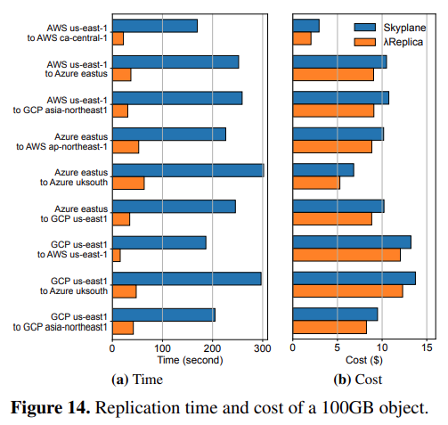
Bulk Replication of Large Objects
Replicating a 100GB object across cloud regions
The high parallelism of 𝜆Replica significantly reduced replication time
Notes:
This paper also evaluates LambdaReplica’s replication time and cost for larger objects. Thanks to its high concurrency, replication time was reduced by 76%–91%, with most tasks completed within one minute. There were also modest improvements in replication cost. It’s not as significant as time because for large objects, data transfer cost dominates.

Slide 21
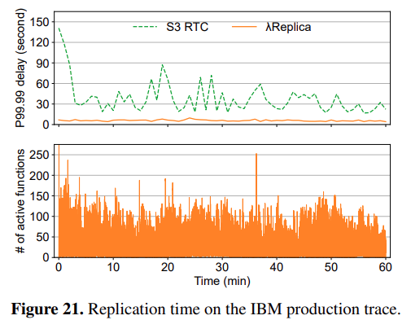
Production Trace Replay
Replaying IBM COS trace between AWS us-east-1 and us-east-2
𝜆Replica reduces tail latency by up to 15x
Notes:
We replayed the complete IBM cloud object storage trace for an hour. LambdaReplica, through extensive parallel execution of functions, reduces the 4 nines latency from over a hundred seconds to under 10 seconds, compared to AWS’s native services S3 Replication Time Control because Lambda Replica is able to adapt to burst almost immediately.

Slide 22
Conclusion
𝜆Replica: a serverless cross-cloud/region object replication system
  Dynamic replication plan for asymmetric platform/region performance
  Part granularity scheduling for performance fluctuation among function instances
𝜆Replica reduces 61%-99% replication time with a cost-saving of up to three orders of magnitude
Open-sourced at:
https://github.com/pkusys/LambdaReplicaCLI
kyleshu@cs.ucla.edu
Notes:
In summary, λReplica is a serverless, cross-cloud/region object replication system designed to optimize replication performance and cost. It features a dynamic replication plan that adapts to the asymmetric performance of different platforms and regions. The system uses part granularity scheduling to manage performance fluctuations across function instances. As a result, λReplica achieves a 61%-99% reduction in replication time and offers cost savings of up to three orders of magnitude.
This concludes my talk. And Junyi will answer questions via Zoom.

